Slide 1

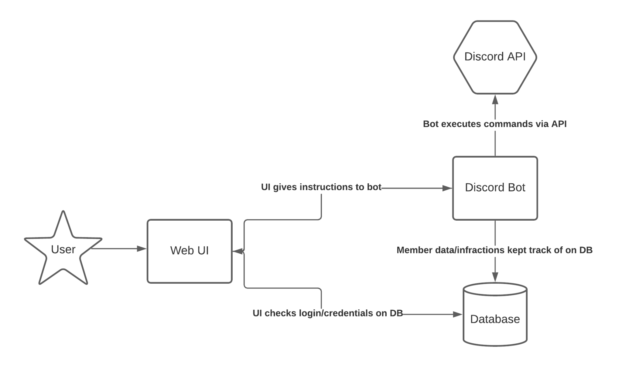


Cloud-based Discord Bot
By: Elijah Baldwin, Sean Larkin, Shane Maloney, Michael Pastorino, and Noah Winand
https://github.com/sm938792/CSC468-Group4.git
Purpose
Create an easy-to-use moderation bot for Discord servers
Utilize a cloud-based infrastructure that allows for continuous deployment
Include a Web UI with buttons to eliminate the need for manually typing out commands
Bot Design
Executes inputted commands from the Web UI to the Discord API
Logs actions to the database for searching and comparing
One instance per server
Real-time updates via Jenkins
Database
MongoDB over redis
Holds login/server info
Stores moderation logs
Web UI takes from DB
Bot gives to DB
Challenges
Few parts to the infrastructure means more group reliance
Communication with the Discord API
Privatization of mongoDB SRV and Discord bot token
Continuous deployment

